Slide 1

June
Strategic Planning Workshop
June 25, 2014
Welcome
Please find a seat with others from your department.

Slide 2
Welcome and Introductions
Dr. Abby Langham
Director of Assessment & Strategic Planning
Notes:
Good morning!
(Introduce myself)
(Ask participants to introduce themselves - name, title, department, one dream for your department next year)
(ABBY TO JOT DREAMS DOWN ON WHITE BOARD or CHART PAPER)

Slide 3
Part I

Slide 4
Introduction to Assessment and Strategic Planning in Student Affairs
Notes:
(Quick Poll)
How many
New professionals? (3 years or less)
Seasoned professionals?
Experience with assessment
Experience with strategic planning
Person responsible for assessment in your department. (WRONG – You are all responsible for continuous improvement of programs, services, and student learning)
That is a quick example of a basic form of assessment.
Knew my research question – how can I best meet the needs of my audience
Did a quick poll
Use results to make improvements throughout presentation

Slide 5
What is Assessment?
A three step process which includes the systematic collection, analysis, and use of information to improve department and/or program effectiveness and/or student learning and development
- Auburn University Division of Student Affairs Common Language
Assessment is any effort to gather, analyze, and interpret evidence which describes institutional, departmental, divisional or agency effectiveness.”
- Upcraft, M. & Schuh, J. (1996). Assessment in student affairs: A guide for
practitioners. San Francisco: Jossey-Bass.
Notes:
Address why assessment evokes fear…
Performance Review
Programs will receive negative findings
Budgets will be cut
But,
Really about knowing how well we are doing
How to make improvements
To measure when and how we’ve reached our intended outcomes
Helps us tell about value and work
It is even more scary to face tough times not knowing how we are doing or to have no way to show others
(Read slide)
In addition, assessment is: Defining what students should be able to do, think, or know at the end of a unit of instruction (defining, that is, the student learning outcomes).
Assessment is determining whether, and to what extent, students can do, think, or know it.
Assessment is also using this information to make improvements in programming and learning.

Slide 6
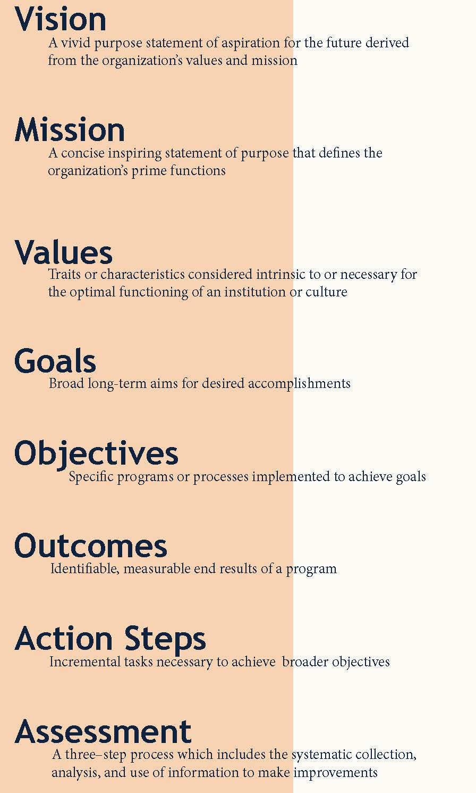
Division of Student Affairs’
Strategic Planning Common Language
Notes:
(GIVE OUT EXPANDED COMMON LANGUAGE)
It is really important to have an understanding as a department or division of what certain terms mean.
This is the DoSA’s Common Language. We just discussed the DoSA definition for Assessment. You all did some hard work last year creating these definitions.
I want to point out our key focus for today. Outcomes. In AU’s DoSA, an outcome is defined as…

Slide 7
Division of Student Affairs Values
Hard Work | Commitment, Responsibility, Dedication, Perseverance, Helping Students Succeed
Education | Personal and Professional Development, Continuous Improvement, Knowledge, Developing Skills, Growth
Honesty and Truthfulness | Integrity, Mutual Respect, Transparency, Morals, Openness
Sound Mind, Body, and Spirit | Balance, Self-Awareness, Health and Wellness, Holistic, Care
Obedience to Law | Respect, Equality, Rights of all, Safe Environment, Inclusion
Human Touch | Compassion, Empathy, Service, Understanding, Caring
Service | Pride, Appreciation, Freedom, Acceptance, Civic Engagement
Auburn | Community, Family, Tradition, Pride, Excellence, Connection
Notes:
Let’s talk specifically about some of the terms on that common language. We’ve discussed assessment and outcomes but what about the other pieces?
Last spring and summer, you all selected DoSA values by using the institutional values expressed in the “Auburn Creed” as a guiding framework. We are to pursue our vision and mission by upholding the following values when accomplishing its strategic goals, objectives, and outcomes.
(READ SLIDE)

Slide 8
DoSA Strategic Plan Overview
Vision
The vision of “Student Success” for the Division of Student Affairs is to empower students to be well-rounded and productive members of society who positively impact the world.
Mission
The mission of the Division of Student Affairs is to cultivate a healthy and supportive campus environment that engages students, advances learning, encourages leadership, and prepares students for future success.
Goal:
Student Learning:
The Division will enhance learning through intentional co-curricular experiences and opportunities.
Goal:
Student Engagement:
The Division will create meaningful opportunities for students to be actively engaged with the campus community.
Goal:
Health, Wellness, & Safety:
The Division will promote a healthy and safe campus community.
Goal:
Professional Readiness:
The Division will prepare students for professional success.
Objectives
Objectives
Objectives
Objectives
Outcomes
Outcomes
Outcomes
Outcomes
Action Steps
Action Steps
Action Steps
Action Steps
4/2/2013
Notes:
(GIVE OUT Vision, Mission, Goal, Objective handout)
You might recognize this image. It is the structure for our 2013-2018 strategic plan.
(READ Vision, Mission, Goals, and point out objectives on handout)
(GIVE OUT Year One Outcomes handout)

Slide 9
Maintaining an Institutional and DoSA Link
DoSA Connections to AU Plan
Vision: Student Success
  Student Learning
  Professional Readiness
  Health & Wellness
  Student Engagement
Five AU Strategic Plan Priorities
Student Success
  Academic Success
  Professional Success
  Personal Health
  Social Success
Faculty Excellence
Research and Scholarship
Public Engagement
Focus Resources on AU Mission and Priorities
Notes:
Notice how our vision, mission, and goals all align with the components of AU Strategic priority 1

Slide 10
AU/ DOSA 2013-2018 Strategic Plan Linkages Update
The DoSA’s 13-14 outcomes match most closely to the following goal/commitment listed under AU Strategic Priority 1: Enhance Student Success and Diversify Enrollment
    AU Strategic Goal 1: Emphasize student retention and achievement through timely degree completion and clear pathways to student success
    AU Strategic Commitment A. Enhance academic support services and student development programs
        To prepare students to excel academically, personally, socially, and professionally through integrated approaches to student success.
Notes:
All DoSA goals were crafted to connect with the university’s plan. In particular, the AU Strategic Priority 1 - Enhancing Student Success and Diversifying Enrollment.
DoSA objectives support the DoSA goals. DoSA outcomes specifically outline measurable ways to achieve the DoSA objectives.
(READ SLIDE)

Slide 11
Strategic Planning Process
Develop Objectives
Develop
SMART Outcomes
Identify Vision & Mission
Identify Values & Goals
Develop
Action Steps
Implement and Assess
Collect Input From Stakeholders
Notes:
Assessment is and should be a part of the strategic planning process.
You will notice that we have now completed one cycle of the is process and are getting ready to do it again for year two (2014-2015).

Slide 12
The Assessment Cycle
Gather Evidence
Interpret Evidence
Mission/Purpose
Goals
Objectives/Outcomes
Implement Outcomes and Methods to Gather Evidence
Make decisions to improve programs; enhance student learning and development;
inform institutional decision-
making, planning,
budgeting, policy, public accountability
Adapted from Peggy Maki, Ph.D. by Marilee J. Bresciani, Ph.D.
Notes:
As you might have figured out by now, assessment is a process.
(talk through the cycle)
Add – sharing success as the final piece

Slide 13
Questions during the Assessment Cycle:
Mission/Purpose/Goals/Objectives/Outcomes
  What are we trying to do?
  What is my program supposed to accomplish?
  What do I want students to be able to do/know as a result of my program?
Implement Outcomes/Methods to Gather Evidence
  How can I reach my target audience?
  What is the best approach to collect information?
Gather Data
  What information is being collected?
  How do we know how well we are doing?
Interpret Evidence
  How well are we doing with what we are trying to accomplish?
  What do our findings tell us about how to proceed?
Make Decisions for Improvement
  How do we use the information to improve or celebrate successes?
  Do the improvements we make contribute to our intended end result?
Adapted from Bresciani, M.J., San Diego State University

Slide 14
Importance of Factors or Forces that Prompt Student Learning Outcomes Assessment
Regional accreditation
Program accreditation
Institutional commitment to improve
Faculty or staff interest in improving student learning
President and/or governing board direction or mandate
Concerns about effectiveness and value
National calls for accountability and/or transparency
Statewide governing or coordinating board mandate
External funding (federal, state, or foundation grants)
State mandate
Participation in a consortium or multi-inst.
Institutional membership initiatives
Other
George D. Kuh, Natasha Jankowski, Stanley O. Ikenberry, & Jillian Kinzie, 2014. National Institute for Learning Outcomes Assessment
No
Importance
Minor
Importance
Moderate
Importance
High
Importance
Notes:
(READ TOP 4 MOST IMPORTANT FACTORS)
The table shows findings from a recent study done in spring of 2013 that involved university provosts and chief academic officers at regionally accredited, undergraduate-degree-granting two- and four- year public, private, and for-profit institutions (n=2,781) (1,202 responded, 43% response rate).
Major Findings:
Stated learning outcomes are now the norm.
The prime driver of assessment remains the same: expectations of regional and program or specialized accrediting agencies.
Substantially more student learning outcomes assessment is underway now than a few years ago and the range of tools and measures to assess student learning has expanded.
Meeting accreditation expectations heads the list for how assessment evidence is used, but internal use by campuses is growing and is considered far more important than external use. (EXAMPLE – My Position)
Provosts perceive substantial support on their campuses for assessment.
Institutions more frequently report assessment results internally than to external audiences.
In general, institutional selectivity is negatively related to assessment activity.
Faculty and staff are the key to moving assessment forward.
Implications:
1. More faculty and staff involvement is essential.
2. Sustaining the recent progress in institutional assessment work must be a priority.
3. Colleges and universities must use assessment results more effectively.
4. Governing boards must make student learning a continuing high priority.
5. Colleges and universities must cultivate an institutional culture that values gathering and using student outcomes data as integral to fostering student success and increasing institutional effectiveness—as contrasted with a compliance exercise.

Slide 15
Why Should We Assess?
Most importantly…
Additionally…
To measure progress
To continuously improve
To make informed decisions
To tell our story
For accountability
For accreditation
For financial justification
Notes:
So, from those findings we know more about why we should assess in general.
(READ SLIDE)

Slide 16
Why Assess in Student Affairs?
To have an end in mind when implementing changes
To document decisions based on results
To have a way to measure if the intended outcomes were achieved
To demonstrate value to stakeholders
To justify expenses during times of reduced budgets
To ensure students are learning and growing from co-curricular experiences
To demonstrate commitment to missions and goals
To help with prioritization
Notes:
In particular, why should we assess in Student Affairs?
(READ SLIDE)
Assessment results are more often used to guide changes in policy and practice at the course and/or department/program level than at the college or institution level.
So, as student affairs professionals who constantly plan programs within many departments, assessment is critical to our effectiveness and efficiency

Slide 17
Examples from Student Affairs
Residence Life:
  Reach of personal safety trainings and workshops (ex: 95% of residents will attend)
Student Involvement:
  Demonstration of student knowledge acquired (ex: leadership skills)
Greek Life:
  GPA comparisons of all-Greek and all-undergraduates
Campus Recreation:
  Rubric to assess fitness instructor readiness
Student Center Operations:
  Satisfaction with reservations process
  Peak traffic hours
Student Conduct:
  Determine key areas of concern for students
Notes:
(USE THESE NOTES WHEN YOU RETURN TO THIS SLIDE FOR PRACTICE)
Residence Life:
Reach of personal safety trainings and workshops (ex: 95% of residents will attend) PROGRAM
Student Involvement:
Demonstration of student knowledge acquired (ex: leadership skills) LEARNING
Greek Life:
GPA comparisons of all-Greek and all-undergraduates PROGRAM
Campus Recreation:
Rubric to assess fitness instructor readiness LEARNING (Demonstration of readiness would be a learning outcome)
Student Center Operations:
Satisfaction with reservations process PROGRAM
Peak traffic hours
Student Conduct:
Determine key areas of concern for students PROGRAM

Slide 18
Strategic Planning and Assessment
It is helpful to have your vision, mission, goals, and objectives in place when planning measurable outcomes.
Strategic planning and assessment have a connection.
Outcomes are the identifiable, end results of a program or activity.
Notes:
We’ve learned a bit about examples of assessment measures, but, what do these measures have to do with strategic planning?
(READ SLIDE)
It is worthwhile to have a direction when determining where to make improvements

Slide 19

What are some types of outcomes?
Program outcomes examine what a program or process is to do, achieve, or accomplish for its own improvement and/or in support of institutional or divisional goals; generally numbers, needs, or satisfaction driven.
  Assessed by student satisfaction, program evaluation, and purely process measures such as attendance.
Learning outcomes examine cognitive skills that students develop through department interactions; measurable, transferable skill development. They are statements indicating what a participant (usually students) will know, think, or be able to do as a result of an event, activity, program, course, etc.
  Assessed by what students have learned.
Notes:
(Read Slide)
(Go back to examples slides)

Slide 20
Assessment Methods
Surveys
Focus groups
Tracking use and participation
Interviews
Photography
Pre/post
Rubrics
Journaling
National assessments (NSSE, CIRP, NCHA)
Notes:
When we have established outcomes, how, then, do we measure them?
(SEE OSTER HANDOUT WITH EXAMPLES OF DIRECT and INDIRECT METHODS)

Slide 21
Assessment Methods
Qualitative and quantitative
One time and longitudinal
Direct - requires students to display their knowledge, behavior or thought processes
Indirect – asks students to reflect upon their knowledge, behaviors or thought processes
Osters, (2013)
Notes:
Our Common Language definition stated that outcomes are identifiable, measurable, end results of a program.
This means that we need to determine appropriate methods of assessment for our outcomes.
(Read slide)

Slide 22
Direct Measures
Benefits of direct measures of student learning
  Provides staff, faculty, and administrators more confidence in the measures and their results because it is the academic standard
  Helps with accreditors who are looking for student learning in the co-curricular and measures of same
Challenges
  Time and expertise needed to develop
  Assessing the “fuzzies” – attitudes and values
  Small “n’s” and the validity of the studies
Bottom line
  Use multiple indirect measures to offset the lack of direct measures
Osters, (2013)
Notes:
When measuring learning outcomes, direct measures are the best approach.
(GIVE OUT ASSESSMENT DECISION TREE HANDOUT)
(Read slide)
Examples of Direct Measures:
Writing sample, portfolio artifacts, presentations, internships or other content-related experiences, demonstration of workplace skills (rubrics)
Indirect measures:
Grades, scores, overall activity or program assessment or evaluation, surveys, attendance or enrollment numbers
22

Slide 23
Common (and still viable) Assessment Measures
Surveys to inform of needs and satisfaction
Surveys to assess outcomes
Focus groups/interviews to inform future assessments or to dig more deeply into existing survey results
Tracking use and participation (numbers)
Osters, (2013)
Notes:
23

Slide 24
New Wave of Assessment Measures
Exit Interviews
Photography
Pre and post tests of knowledge
Observations with documentation
One minute papers
Rubrics
Reflective journals
Reflective conversations/writing
Combination of the above
What are some assessment measures you have used?
Osters, (2013)
Notes:
(Read slide)
Open floor for discussion
24

Slide 25
Questions?

Slide 26
References
Bresciani, M.J., 2010. Enhancing outcomes-based assessment for student affairs. San
Diego State University.
Campus Labs. (2013). Writing Learning Outcomes Worksheet. Retrieved from:
https://auburn.campuslabs.com/app/ClientWe b/Documents/DocumentList.aspx
Kuh, G. Jankowski, N., Ikenberry, S., & Kinzie, J. (2014) Knowing what students
know and can do: The current state of student learning outcomes
assessment in U.S. colleges and universities. National Institute for Learning
Outcomes Assessment. Retrieved
http://www.learningoutcomeassessment.org/documents/2013%20Abridge d%20Survey%20Report%20Final.pdf
Osters, S. (2013). Developing and assessing outcomes in the co-curricular experience.
Presentation prepared for Auburn University’s
Division of Student Affairs A-Team, April 2, 2013
Upcraft, M. & Schuh, J. (1996). Assessment in student
affairs: A guide for practitioners. San Francisco:
Jossey-Bass.

Slide 27
Assessment Methods in Detail
Presented by:
Branden Farmer
  Campus Recreation
  Assessment Team Member
  and
Dr. Kristee Treadwell
  Student Counseling Services
  Assessment Team Member
Notes:
(When finished, ask the attendees)
What assessment methods have you used. What worked well? What didn’t?

Slide 28
Response Rates, Incentives, and Marketing
Facilitated by:
Dr. Virginia Koch
  Residence Life
  Assessment Team Member
Notes:
(Roundtable discussion)
Prompts if needed:
Who has used an incentive to improve participation in a survey?
How did you obtain the item/s?
What ways have you advertised the launch of your survey?

Slide 29
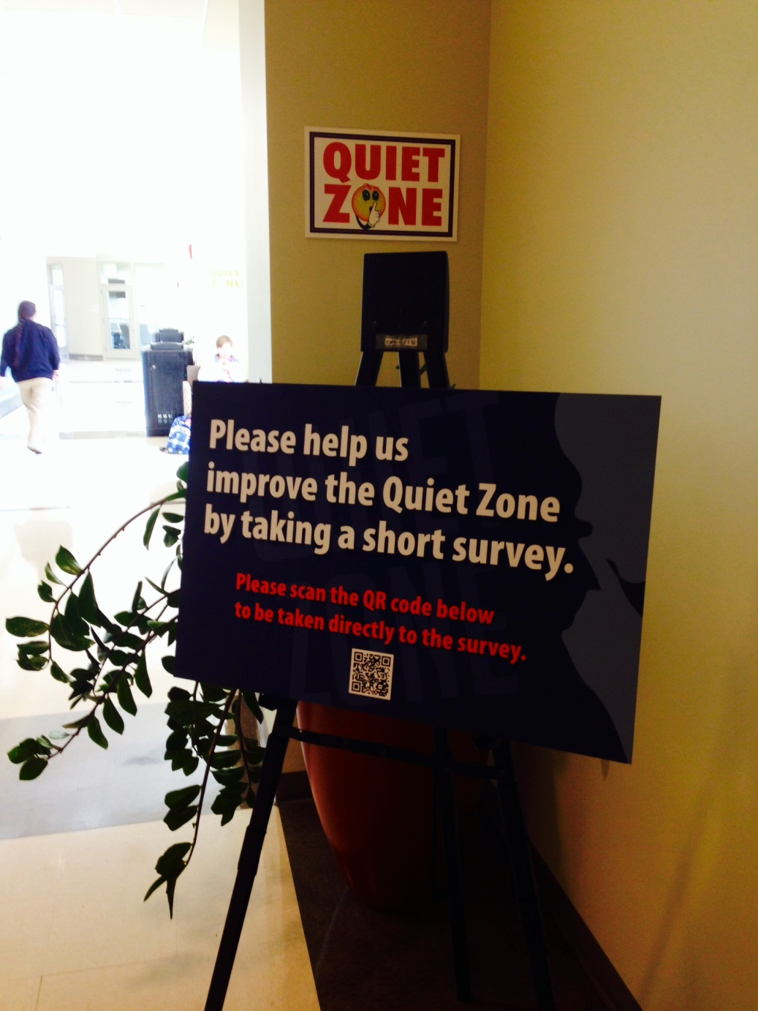
Example
Student Center Operations – Quiet Zone Survey

Slide 30
Snack Break
(Discuss how you could use some of these methods to assess your outcomes next year.)

Slide 31
Part II

Slide 32
WRITING STUDENT
LEARNING OUTCOMES:
An Introduction
June Strategic Planning Workshop
June 25, 2014
Abbygail Langham, Ph.D.
Director of Assessment & Strategic Planning

Slide 33
Today’s Learning Outcomes
As a result of attending this session, attendees will be able to:
Differentiate between program and learning outcomes.
Identify the reasons it is important to write outcomes.
Apply the ABCD structure when writing an outcome.
Assess whether an outcome is meaningful, manageable, and measurable.
Apply Bloom’s Taxonomy when creating a learning outcome.
Evaluate whether an outcome is SMART.
Notes:
I would not be demonstrating a good example if I failed to present you with learning outcomes for this segment given the topic of today’s discussion. Today’s learning outcomes are as follows…

Slide 34
Measuring a Culture of Evidence

Slide 35
 | A Culture of Good Intentions | A Culture of Justification | A Culture of Strategy | A Culture of Evidence
Intentionality (Thoughtfulness in action or decision) | People have a sense that they are doing good things. | People can describe what they are doing (i.e. operational or procedural specificity). | People can describe what they are accomplishing (i.e. strategic pertinence, how what they are doing relates to mission and goals). | People know that they are doing the right things and can describe why they are doing them, and what they are accomplishing through them.
Perspective (Relative to position, institutional role and general point of view) | Incidental / Opportunistic. Recognize data is important, but do not make any particular efforts to collect it. | After-the-Fact. Data is used retroactively as justification for predetermined positions or prior decisions. | Before-the-fact. Assessment is designed with an end in mind. (e.g. Identification of learning outcomes, how the data will be used) | Real Time / Continuous. Data is collected and regularly used to inform processes. Data helps us close the loop on improvement processes and educational outcomes.
Critical Linkages (Connections that manage movement and relationships) | Unclear / Opaque. Data, when collected, is not shared beyond assessors, so connections cannot be made. | Cloudy. Assessment conducted from a defensive posture, especially related to questions of budgetary and operational efficiency. | Translucent. Assessment understood and shared, but only with allies or key partners. Scope is limited to mid-managers. | Clear / Transparent. Outsiders can see and understand contributions to student and institutional success. Assessment is shared with all stakeholders.
Initiatives and Directions (Goals, programs, projects, and plans) | Determined by whim, interest, opportunity. | Administration initiates assessment and it is done only when asked for or required. | Directors own and initiate assessment. Data describe the current situation. | All stakeholders own assessment. Success is operationalized, concretely described, and evaluated based on evidence.
Planning Processes (Strategic planning, goal setting, measuring outcomes) | Vague and individualized. Success is vague or interpretive, and evaluated based on “feel,” intent and effort. Collective or strategic planning does not exist. | Sporadic and limited to immediate question or application. Data linked retroactively to strategic context, goals, expectations, etc. but not planning-oriented. | Organized, routinized, and localized. Data informs deliberate cyclical or episodic strategic planning exercises. | Ongoing, strategic and clearly linked to past and future. Triangulation of findings through multiple/established assessments. Data incorporated into continuous strategic thinking.
Spurlock, R.S. & Johnston, A.J. (2012). Measuring a Culture of Evidence. In M. Culp & G. Dungy (Eds.), Building a Culture of Evidence (p. 65). Washington, DC: NASPA.
Notes:
Example of a rubric.
Scale is across the top
Items/criteria are the left
(GIVE HANDOUTS OF RUBRIC WITH BOTH ORANGE AND BLUE HEADINGS )

Slide 36
Measuring a Culture of Evidence
First
Second
Use the handout of the rubric with the blue heading to determine where your department is in creating a culture of evidence in each rubric category.
Discuss these scores with the other person from your department.
  Where do your results match/differ?
  Where is there room for improvement?
Directors, keep these results to compare your growth at a later date.
Use the handout of the rubric with the orange heading to determine where the Division is in creating a culture of evidence in each rubric category.
Division scores will be compiled.

Slide 37
 | A Culture of Good Intentions | A Culture of Justification | A Culture of Strategy | A Culture of Evidence
Intentionality (Thoughtfulness in action or decision) | People have a sense that they are doing good things. | People can describe what they are doing (i.e. operational or procedural specificity). | People can describe what they are accomplishing (i.e. strategic pertinence, how what they are doing relates to mission and goals). | People know that they are doing the right things and can describe why they are doing them, and what they are accomplishing through them.
Perspective (Relative to position, institutional role and general point of view) | Incidental / Opportunistic. Recognize data is important, but do not make any particular efforts to collect it. | After-the-Fact. Data is used retroactively as justification for predetermined positions or prior decisions. | Before-the-fact. Assessment is designed with an end in mind. (e.g. Identification of learning outcomes, how the data will be used) | Real Time / Continuous. Data is collected and regularly used to inform processes. Data helps us close the loop on improvement processes and educational outcomes.
Critical Linkages (Connections that manage movement and relationships) | Unclear / Opaque. Data, when collected, is not shared beyond assessors, so connections cannot be made. | Cloudy. Assessment conducted from a defensive posture, especially related to questions of budgetary and operational efficiency. | Translucent. Assessment understood and shared, but only with allies or key partners. Scope is limited to mid-managers. | Clear / Transparent. Outsiders can see and understand contributions to student and institutional success. Assessment is shared with all stakeholders.
Initiatives and Directions (Goals, programs, projects, and plans) | Determined by whim, interest, opportunity. | Administration initiates assessment and it is done only when asked for or required. | Directors own and initiate assessment. Data describe the current situation. | All stakeholders own assessment. Success is operationalized, concretely described, and evaluated based on evidence.
Planning Processes (Strategic planning, goal setting, measuring outcomes) | Vague and individualized. Success is vague or interpretive, and evaluated based on “feel,” intent and effort. Collective or strategic planning does not exist. | Sporadic and limited to immediate question or application. Data linked retroactively to strategic context, goals, expectations, etc. but not planning-oriented. | Organized, routinized, and localized. Data informs deliberate cyclical or episodic strategic planning exercises. | Ongoing, strategic and clearly linked to past and future. Triangulation of findings through multiple/established assessments. Data incorporated into continuous strategic thinking.
Division findings during June 4, 2013 June Goal Summit
Notes:
(Discuss findings from last year)
(Ask participants if there were any shifts)

Slide 38
Why Write Outcomes?
Reasons:
To have a formalized way to measure student learning
To ensure emphasis of activity or material aligns with Division, College, and University strategic priorities
To offer students a picture of what knowledge they should acquire/what is expected of them
To have documentation for accountability/accreditation purposes
To make continuous improvements
“Because a strong emphasis on student learning is the primary key to retention through graduation”
“Because learning is the primary activity and goal of the college environment – both inside and outside of the classroom”
Osters, (2013)
Notes:
Now we know where we are as a Division with building a culture of evidence.
There is still work to be done.
We’ve learned about the different types of outcomes – Program and Learning. Refer back to your common language handout to see these definitions.
But, why should we write outcomes in the first place?
(Read slide)
Additional reasons to write outcomes are:
Communicate expectations to learners
Act as a template for course, activity, or program design
Guide selection/design of appropriate assessments
Allow staff members/leaders to match teaching strategies to stated outcomes
Allow faculty, staff, and Institutional researchers to assess the impact of instruction
Clearly communicate graduates’ skills to prospective employers
Provide benchmarks for formative, summative and prior learning assessment
Source: How to Write S.M.A.R.T
Student Learning Outcomes; Presenter: Ms. Aundrea D. Wheeler
Bishop State Community College
Mobile, AL

Slide 39
The Purpose Of Outcomes Based Assessment
To answer some simple questions:
  What is it that we do?
  Why do we do it?
  How well do we do it?
  How do we know that we do it well?
  What improvements and changes do we make from what we learn?
  Do the improvements work?
To genuinely engage faculty, staff and students in the day-to-day reflection of answering these simple questions
To demonstrate a commitment to systematic examination of the quality of all we do to improve our programs and departments
Osters, (2013)
Notes:
What is the purpose of outcomes based assessment?
(Read slide)
All good teachers and staff members instinctively do outcomes assessment.
Whenever you make an observation when hosting an event or when you use feedback to improve a program for next year, and reconsider your approach in light of that information, you’re doing a form of assessment. Outcomes assessment simply makes that process more systematic.
Ask yourselves these questions to be sure that you are actually engaged in outcomes assessment:
Are you demonstrating, in more tangible ways than simply pointing to attendance patterns and institutional data, that learning is taking place in your discipline? If you are, you are doing outcomes assessment. You are documenting student learning.
2. Are you identifying, with some precision, areas in your department where learning is deficient, and working actively to improve learning? If so, you are doing outcomes assessment.
You are trying to enhance and improve student learning in light of evidence you've collected about it. (Source: http://www.umkc.edu/assessment/overview.cfm)

Slide 40
Year One Outcomes Review
Take a moment and review your department’s outcomes for year one (2013-2014) of the DoSA’s 2013-2018 strategic plan.
Identify whether each outcome for your area is a program outcome or a learning outcome
Notes:
(GIVE YEAR ONE OUTCOMES HANDOUT)
(Read slide)
(Allow 2-3 minutes for activity)
(Ask for volunteers to share)

Slide 41
Structure of a Learning Outcome: The ABCDs
Audience/Who
  To whom does the outcome pertain?
Behavior/What
  What do you expect the audience to know/be able to do?
Condition/How
Under what conditions or circumstances will the learning occur?
Degree/How much
  How much will be accomplished, how well will the behavior need to be performed, and to what level?
Jot down the ABCDs for a sample learning outcome in your area.
Notes:
Now we have a basic understanding of outcomes, but how do we write or assemble them?
(Read slide)
(Allow 2-3 minutes for the activity)

Slide 42
Example and Practice 1
Example:
Students who attend advising sessions will choose courses that fulfill their chosen degree requirements.
Audience/Who
Behavior/What
Condition/How
Degree/How much
DoSA Practice:
Using your ABCDs, write a sample learning outcome for your area.
Notes:
(Read slide)
(Allow 5 minutes or so for activity)
Did your outcome statement include the ABCD’s?

Slide 43
The 3 Ms
Meaningful: How does the outcome support the departmental mission or goal?
Manageable: What is needed to foster the achievement of the outcome? Is the outcome realistic?
Measurable: How will you know if the outcome is achieved? What is the assessment method?
Check your outcome against these criteria:
Notes:
(Read slide)
(Allow 2-3 minutes for participants to spot check their outcomes against the 3 M’s criteria)

Slide 44
Example and Practice 2
Example:
To improve this learning outcome statement: “RAs will be more self-aware as leaders”, you could make it:
“As a result of attending Resident Advisor training, hosted by the Office of Residence Life, Resident Advisors will be able to accurately assess the strengths and weaknesses of their leadership skills.”
DoSA Practice
Revise the sample learning outcome that you wrote for your area.
Is it all three Ms?
  Meaningful: How does the outcome support the departmental mission or goal?
  Manageable: What is needed to foster the achievement of the outcome? Is the outcome realistic?
  Measurable: How will you know if the outcome is achieved? What is the assessment method?
Notes:
(Read left column slide)
(Read right column slide)
Now you know where your outcome needs revision.
Take a few moments to rewrite it to include all 3 M’s.
(allow 2-3 minutes for activity)
(Ask for someone to share an example)

Slide 45
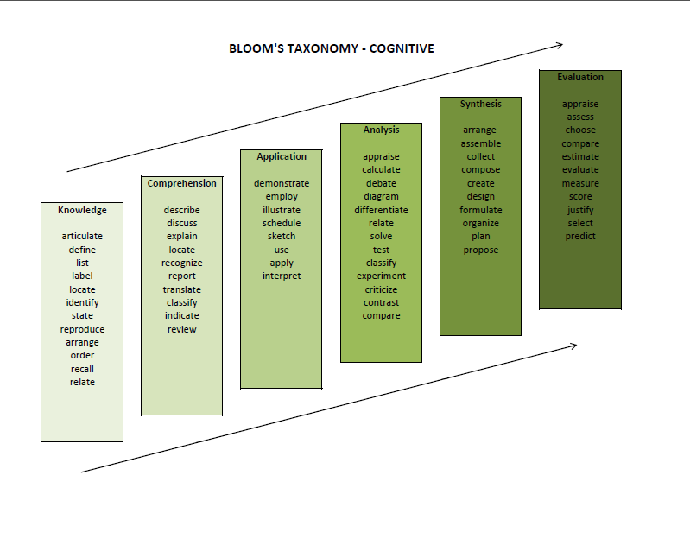
Bloom’s Taxonomy
Source:
Notes:
(Give out Bloom’s Handout)
Bloom’s taxonomy provides a useful framework for identifying and describing the development of student learning from the acquisition of foundation knowledge and skills through the characteristics of expert knowledge.
Basic to Complex
(Ask participants to replace their action verb for a Bloom’s action verb if they have not already done so)
Utilize this graphic to identify words that describe the behaviors that you are expecting your audience to be able to perform as a result of participation in your program/service.
Source: http://uwf.edu/cutla/writingslo.cfm

Slide 46
Initial Problems Encountered When Writing Learning Outcomes:
Describe program outcomes, rather than learning outcomes
People don’t use Bloom’s taxonomy verbs and instead use vague terms like: appreciate, become aware of/familiar with, know, learn, value…
Too vast/complex, too wordy
Multiple outcomes in one learning outcome statement (the word “and” is usually a clue!)
Not specific enough (e.g., effective communication skills)
Notes:
(Read slide)
Write student learning outcomes so that students and individuals who do not share your disciplinary expertise will understand the knowledge, skills, abilities, and values they can expect to attain in your program. Describe the outcome in language that a non-specialist will understand.
Tips:
Write all outcomes as complete sentences.
Make sure you are writing outcomes that are measurable.
Write outcomes as standalone statements so that they make sense if nothing else is next to them (Include name of office).

Slide 47
Common Mistakes in Writing Learning Outcomes
The learning outcomes don’t align with department, college, or university goals
Outcomes include words that are hard or impossible to measure (understand, appreciate, know about, become familiar with, learn about, become aware of)
Outcomes include too many skills in one statement
Outcomes measure satisfaction or performance evaluation rather than learning of the student
There are too many learning outcomes
Only one person wrote, reviewed, edited and implemented the outcome
Osters, (2013)

Slide 48
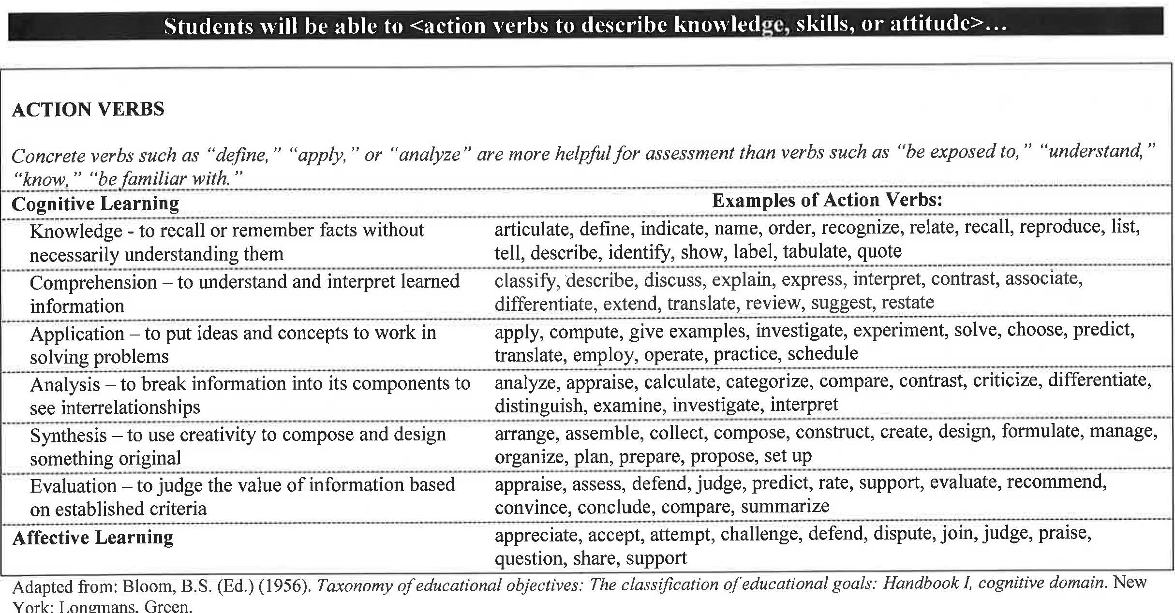
Bloom’s Taxonomy – Action Verbs
Osters, (2013)

Slide 49
What does it mean to be SMART?
S – Specific
M – Measurable
A – Attainable/Ambitious
R – Relevant/Resource-Conscious
T – Time-Sensitive/Timely
Notes:
Another way to strengthen outcomes is to make sure they are SMART.
(Read slide)
S
Who do we want to impact? Who is involved?
What do we want to achieve?
Where do we want this accomplishment to take place?
Why are we working to accomplish this task?
Which areas will be effected?
M
How do you know it is progress if it is not measurable?
Information can be collected with either or both quantitative and Qualitative methods.
How much?
How many?
How will we know if we’ve achieved what we set to accomplish?
A
outcomes should not be too extreme. They should be reachable while still stretching the student/organization to do or be more.
Can this be accomplished?
Will this push us to be our realistic best?
How will we achieve this?
R
Some tasks might be specific, measurable, and attainable; however, they may not be pertinent to moving the student/organization forward.
Does the student/organization really need this?
Is this effort worthwhile?
Will this have an effect on the desired goal?
Do the benefits of doing this outweigh the costs?
How does the student/organization benefit from this?
T
outcomes should be planned within a given timeframe. Deadlines help with completion.
When will the student/we do this?
Is it feasible within the planning timeframe to do this?
Is it the right time for the student/organization to work on this?

Slide 50
Example and Practice 3
Example
DoSA Practice
Revise the sample learning outcome that you wrote for your area so that it is SMART.
When ready, discuss with your neighbor about how you made your outcome SMART.
Upon completion of the course, students will be able to analyze a documented nutritional problem.
S – Specific
M – Measurable
A – Attainable/Ambitious
R – Relevant/Resource-Conscious
T – Time-Sensitive/Timely
Notes:
(Read left column)
(Read right column)
(Allow 5 minutes for exercise)
(Ask participants to share an example or two)

Slide 51
Student Learning Outcome Template
As a result of students participating in ____________________________, provided by the Office of _____________,
they will be able to [insert action verb] ____________________________.
Notes:
When in doubt about where to start with this process, there is always a template.
You can use this template to get started and the check for the ABCDs, 3M’s, and to see if your outcome is SMART.
(Read slide)

Slide 52
Questions?

Slide 53
WRITING PROGRAM OUTCOMES:
An Introduction
June Strategic Planning Workshop
June 25, 2014
Abbygail Langham, Ph.D.
Director of Assessment & Strategic Planning

Slide 54
Program Outcome Components
Unit/Object/Who
  Who or what is the unit of measurement? (Parents, dollars, complaints, etc.)
Behavior/What
  What do you expect to happen or change?
Condition/How
  Under what conditions or circumstances will the outcome occur?
Degree/How much
  What is the success criteria? What specific numbers or direction will you see?
Jot down the ABCDs for a sample program outcome in your area.
Notes:
With program outcomes you ask yourself -What is the end result of this program or service from our perspective
(Read slide)
(Allow 2-3 minutes for activity)

Slide 55
Example and Practice 1
Example:
Upon completion of customer service training for Foy Information Desk employees, hosted by Student Center Operations, 90% of visitors will be satisfied with their desk interactions during Camp War Eagle.
Unit/Object
Behavior/What
Condition/How
Degree/How much
DoSA Practice:
Using your ABCDs, write a sample program outcome for your area.
Notes:
(Read slide)
(Allow 5 minutes or so for activity)
Did your outcome statement include the ABCD’s?

Slide 56
Degrees with Program Outcomes
Set Point
  80% of parents
  1.5 million dollars
  2000 students
  “accomplished” or higher
Direction
  40% decrease in complaints
  300 additional parents attending
  No change
  Same as peers
Notes:
It is most helpful to have a set point in mind with program outcomes. That way you know if you’ve accomplished what you intended.
Sometimes it is hard to do that so you could list - decrease, increase, no change, etc.

Slide 57
The 3 Ms
Meaningful: How does the outcome support the departmental mission or goal?
Manageable: What is needed to foster the achievement of the outcome? Is the outcome realistic?
Measurable: How will you know if the outcome is achieved? What is the assessment method?
Check your outcome against these criteria:
Notes:
(Read slide)
(Allow 2-3 minutes for participants to spot check their outcomes against the 3 M’s criteria)
Now you know where your outcome needs revision.
Take a few moments to rewrite it to include all 3 M’s.
(allow 2-3 minutes for activity)
(Ask for someone to share an example)

Slide 58
Example and Practice 2
Example
DoSA Practice
Campus Recreation will train and certify 70% of professional employees to be CPR instructors using the American Red Cross Protocol.
Revise the sample program outcome that you wrote for your area so that it is SMART.
When ready, discuss with your neighbor about how you made your outcome SMART.
S – Specific
M – Measurable
A – Attainable/Ambitious
R – Relevant/Resource-Conscious
T – Time-Sensitive/Timely
Notes:
(Read left column)
(Read right column)
(Allow 5 minutes for exercise)
(Ask participants to share an example or two)

Slide 59
Activity #3: Revisiting What We Have Learned
For each of the statements below, identify…
  Is the statement a program or learning outcome statement?
  What information is missing? How could the outcome be strengthened?
The Undergraduate Research Office will increase support for student attendance at regional, national, and international conferences.
Students will be able to demonstrate effective communication skills a result of participating in the Leadership Program.
The Wellness Program will increase the number of smoking cessation seminars offered by 20% by hiring a graduate assistant to conduct the seminars.
Students will identify ten behaviors and/or characteristics of healthy relationships with others after attending this seminar.
The number of personal solicitations focused on scholarship needs will increase.
Students and faculty will receive more information about co-curricular transcripts and the number of students completing transcripts will increase.
Notes:
(Read first two bullets)
(2-3 Minutes)
On your own paper, number 1-6, and write program or learning outcome for each one and jot down what might be missing or how they could be strengthened.

Slide 60
Activity #3: Distinguishing Between Program And Learning Outcomes (Answers)
For each of the statements below, identify…
  Is the statement a program or learning outcome statement?
  What information is missing? How could the outcome be strengthened?
The Undergraduate Research Office will increase support for student attendance at regional, national, and international conferences. PROGRAM
Students will be able to demonstrate effective communication skills a result of participating in the Leadership Program. LEARNING
The Wellness Program will increase the number of smoking cessation seminars offered by 20% by hiring a graduate assistant to conduct the seminars. PROGRAM
Students will identify ten behaviors and/or characteristics of healthy relationships with others after attending this seminar. LEARNING
The number of personal solicitations focused on scholarship needs will increase. PROGRAM
Students and faculty will receive more information about co-curricular transcripts and the number of students completing transcripts will increase. PROGRAM
Notes:
How might these be strengthened?
(#2 – what communication skills specifically?
#3 – listing the GA might be more of an action step
#6 - “and”)

Slide 61
References
Campus Labs. (2013). Writing Learning Outcomes
Worksheet. Retrieved from:
https://auburn.campuslabs.com/app/ClientWe b/Documents/DocumentList.aspx
Osters, S. (2013). Developing and assessing outcomes in the co- curricular experience. Presentation prepared for
Auburn University’s
Division of Student Affairs A-Team, April 2, 2013
Upcraft, M. & Schuh, J. (1996). Assessment in student
affairs: A guide for practitioners. San Francisco:
Jossey-Bass.

Slide 62
PART III

Slide 63
WRITING OUTCOMES FOR YEAR TWO (2014-2015)
June Strategic Planning Workshop
June 25, 2014
Abbygail Langham, Ph.D.
Director of Assessment & Strategic Planning

Slide 64
Assessment Cycle
Gather Data
Interpret Evidence
Mission/Purpose
Goals
Objectives/Outcomes
Environment
Budget
Politics
Implement Methods to Deliver Outcomes and Methods to Gather Data
Make decisions to improve programs; enhance student learning and development;
inform institutional decision-
making, planning,
budgeting, policy, public accountability
Scholarship
Accountability
S. Osters. 2013. Adapted from Maki, P. L. (2002). Developing an assessment plan to learn about learning. The Journal of Academic Librarianship.
Notes:
Talk about things on the periphery and why it is important to be strategic or else priorities shift to more of triage work than intentional assessment and improvement

Slide 65
What do you want to accomplish?
NOTES
It might be helpful to think through to 2018 and reverse engineer by year.
It is a good idea to use findings from your year one outcomes to drive decisions about future improvements, programs, services, and learning.
Think back to the DoSA’s objectives, goals, mission, and vision and the AU Strategic Plan. Does what you want to accomplish support these items?
Working in your department groups, make a list on chart paper of what you want to accomplish next year.
Notes:
(Allow 10 to 15 minutes for this activity or longer if needed)

Slide 66
ABCD’s
Determine if each item on your list will be a program or a learning outcome.
Identify the ABCD’s for each outcome.
LEARNING OUTCOMES
Audience/Who
Behavior/What
Condition/How
Degree/How much
PROGRAM OUTCOMES
Unit/Object
Behavior/What
Condition/How
Degree/How much
Notes:
(Allow 10 to 15 minutes for this activity or longer if needed)

Slide 67
3M’s, Bloom’s, and SMART
Remember to check for:
  Bloom’s action verbs
  3M’s
    Meaningful: How does the outcome support the departmental mission or goal?
    Manageable: What is needed to foster the achievement of the outcome? Is the outcome realistic?
    Measurable: How will you know if the outcome is achieved? What is the assessment method?
  SMART
On chart paper, revise the ABCD components for each item to be full outcome statements.
Notes:
(Allow 10 to 15 minutes for this activity or longer if needed)

Slide 68
How will you know you’ve accomplished it?
Discuss with others from your department about how you will measure each outcome.
Write the assessment method next to each outcome.
Use your handouts to help guide you through this process.
Notes:
(Allow 10 to 15 minutes for this activity or longer if needed)

Slide 69
Meeting SACS Standards
As a group, use the Effectiveness Peer Review Rubric to refine your outcomes one step further.
Are you able to check the “Met” column for each one?
When finished, invite members from another department to review your outcome using the rubric.
Revise further based on their feedback if necessary.
Notes:
First column:
(Allow 10 to 15 minutes for this activity or longer if needed)
Second column:
(Allow 10 to 15 minutes for this activity or longer if needed)

Slide 70
Completed First Drafts
Use the outcome form to rewrite your revised outcomes.
Match your outcomes to AU’s and the DoSA’s strategic plans.
When finished, turn in to Dr. Langham in order to get a copy made.

Slide 71
Questions?
Please fill out the session evaluation.
Thanks for your participation!

Slide 72
References
Campus Labs. (2013). Writing Learning Outcomes
Worksheet. Retrieved from:
https://auburn.campuslabs.com/app/ClientWe b/Documents/DocumentList.aspx
Osters, S. (2013). Developing and assessing outcomes in the co- curricular experience. Presentation prepared for
Auburn University’s
Division of Student Affairs A-Team, April 2, 2013
Upcraft, M. & Schuh, J. (1996). Assessment in student
affairs: A guide for practitioners. San Francisco:
Jossey-Bass.

